Slide 1
Environmental Sample Analysis by Means of Neutron Activation Analysis and Gamma-Ray Counting
Eduardo Zagal
Peter Thomas
Shreyas Srinivasan
Zach Levine

Slide 2
Project Overview
Analyze existing spectra of various kelp samples from different geographical regions to determine isotopic composition of the samples
Perform additional NAA measurements on kelp and seaweed at MNRC
Compare NAA measurements with gamma-ray counting experiment results
Identify other samples of interest, primarily from the bay, and perform measurements and analysis on these samples
Write an article summarizing results of the various measurements and publish to the RadWatch website

Slide 3
Project Goals
Compare the composition of kelp samples from throughout the Pacific Coast (Alaska to Chile)
Identify inconsistencies between samples and determine the sources of inconsistency
Publish article to RadWatch website summarizing results
Publish relevant data for the public to understand on the RadWatch website

Slide 4
Roles
Shreyas:
Maintain living document(s) as necessary
Compile group work into LATEX
Lead in publishing to Radwatch site
Zach:
Lead in communicating with instructor on a weekly basis on behalf of the group
Lead in communicating with points of contact on behalf of the group
Generate efficiency curve(s) for detectors being used
Eduardo:
Find new, useful samples for more analysis
Help with new sample data analysis
Lead in writing article(s) to be published
Peter:
Find new, useful samples for more analysis
Lead in data analysis for new samples tested

Slide 5
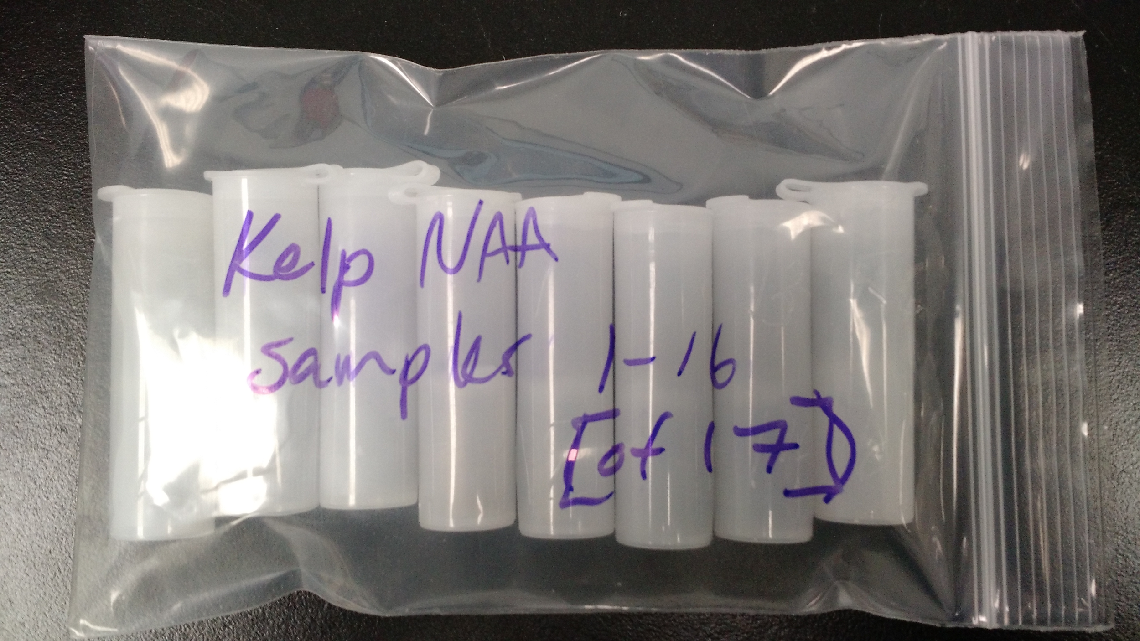
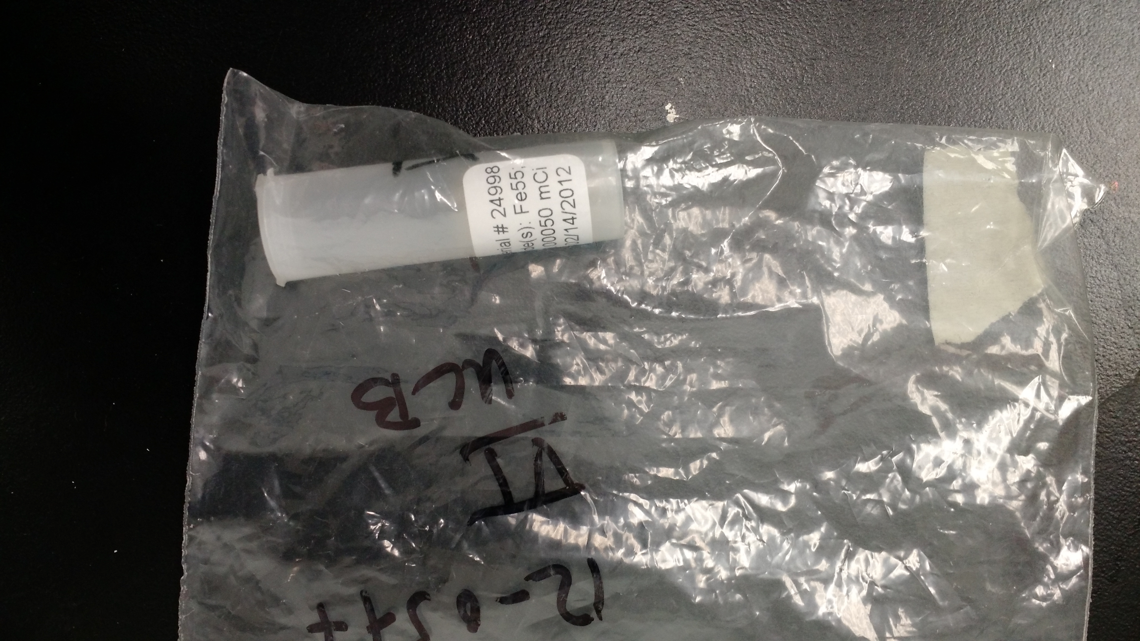
Critical Equipment
Germanium Detector in 1110C
Lead Shielding
GammaVision
MNRC reactor to irradiate samples
The TRIGA
Sample Vials
Marinelli Beaker

Slide 6
Concentration Calculation Procedure

Slide 7
Standard Pottery
What is it?
Clay pottery which contains a wide range of chemical elements
Neutrons can activate elements in the pottery (NAA)
Why is it used in our project?
Standard pottery essentially acts as chemical fingerprinting for many different elements
The analysis of the pottery is sensitive to minor components
Most importantly, the pottery may be used to determine elemental compositions in a given unknown sample
Standard pottery is known for its high accuracy

Slide 8
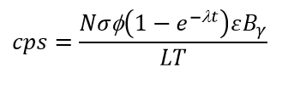
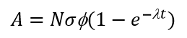

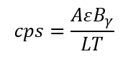
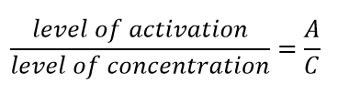
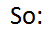
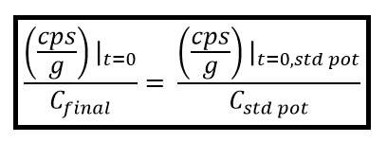
Concentration Calculation (Ratio Method)
The counts per second (cps) for a given isotope’s decay is:

Slide 9
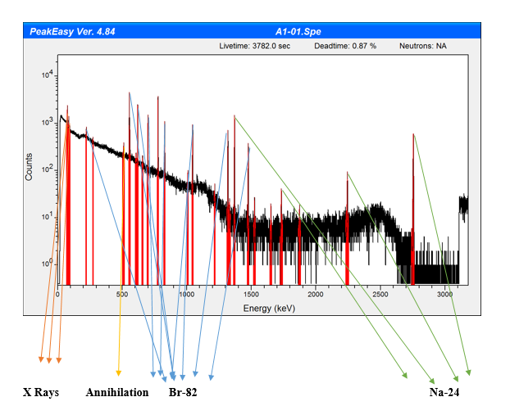
Initial Kelp NAA Energy Spectra

Slide 10
Initial Kelp Sample Findings
Isotope | cps/g at start of counting | cps/g at end of irradiation | cps/g Standard Pottery | Sample concentration
24Na | 0.001539573 | 36.66898685 | 10387.98988 | 1.84E-05
82Br | 0.002376476 | 0.170106852 | 4.100082189 | 2.03E-07
76As | 0.00024557 | 0.083432625 | 103.84 | 2.47E-08

Slide 11
New Samples for NAA
Seaweed
Potassium, Sodium, Calcium, Magnesium and Sulfur
Trace amounts of Zinc, Copper, Chlorine, Cobalt, Manganese, Selenium, Bromine, Iron, and Arsenic
Seashells
Calcium, Carbon, Oxygen
Fish
Carbon, Oxygen, Hydrogen, Sulfur, and Nitrogen
Trace amounts of various metals, such as Sodium, Aluminum, and Iron

Slide 12
Irradiation Procedure
Short Run
Long Run

Slide 13
Short Run Findings

Slide 14
Long Run Findings
Fish
Seashells
Seaweed

Slide 15
RadWatch website
Show published article and data. Perhaps an interactive map if time permits during the project

Slide 16
Acknowledgements
Keenan Thomas
Professor Kai Vetter

Slide 17
Questions?

